Slide 1

Equity Considerations in Prop 1 Housing
Mental Health America of California’s Perspective

Slide 2
About Mental Health America of California
Peer run organization
The mission of MHAC is to assist and encourage communities, families and individuals to experience hope, wellness and recovery from mental health and substance use disorder issues. The people and communities we aim to serve include those of all ages; sexual orientation, gender identity or expression; language, racial and ethnic backgrounds, national origin, and immigration status; spirituality and religious affiliations; or socioeconomic status.
The Statewide California affiliate of Mental Health America
  5 affiliate organizations and 1 associate organization

Slide 3
About Me
Director of Public Policy at Mental Health America of California (MHAC)
Former poverty law attorney
Person with lived experience
Family member of an unhoused person

Slide 4
Equity Considerations in Prop 1 BHSA Housing
Equity within housing services
Equity in access to housing services

Slide 5
Equity Considerations Within Prop 1 Behavioral Health Services Act Housing
Mental Health America of California’s Perspective

Slide 6
Changes to the MHSA
Renamed to the Behavioral Health Services Act (BHSA)
Requires Counties to spend up to 30% of their MHSA funds on “housing services”
Eliminates the General Systems Development category (core outpatient services, culturally responsive services and peer services)
Takes an additional 5% off the top for new statewide purposes (population-based prevention and workforce)
Adds individuals with Substance Use Disorder (and no co-occurring serious mental health challenges) as an optional population

Slide 7
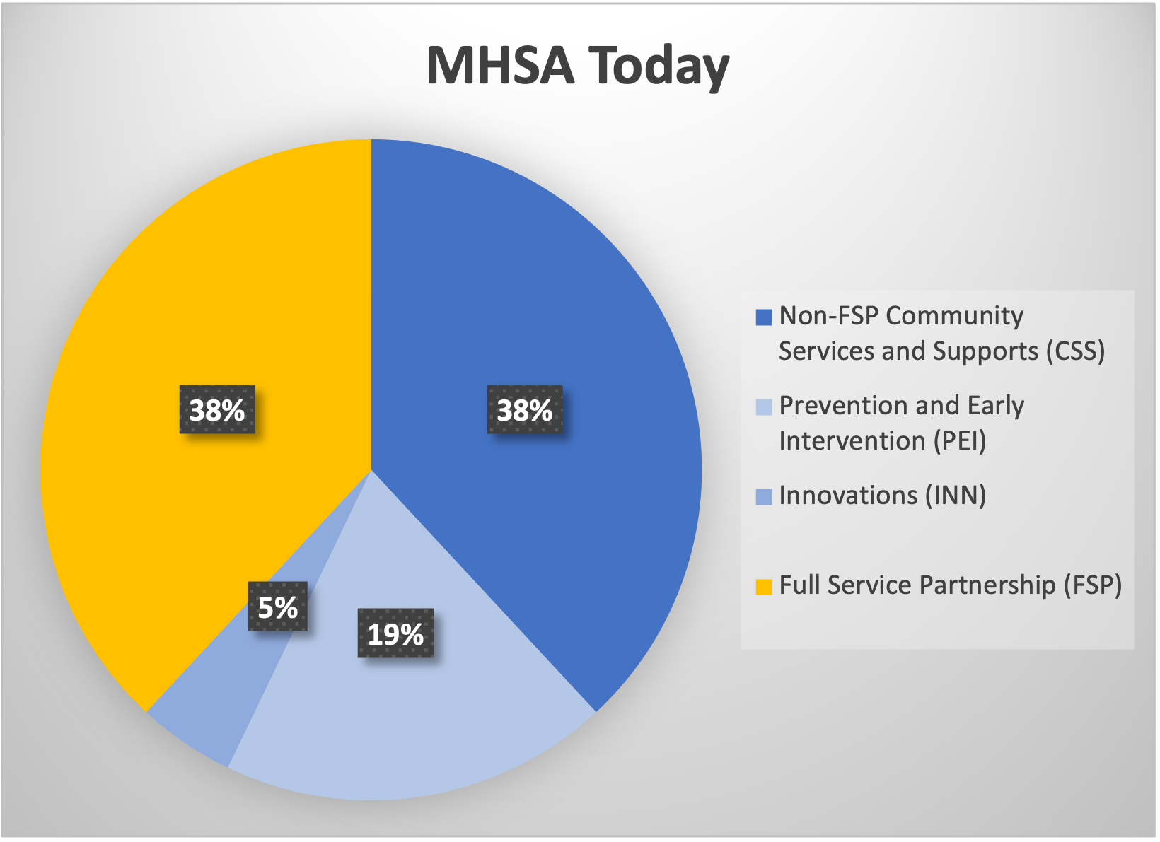
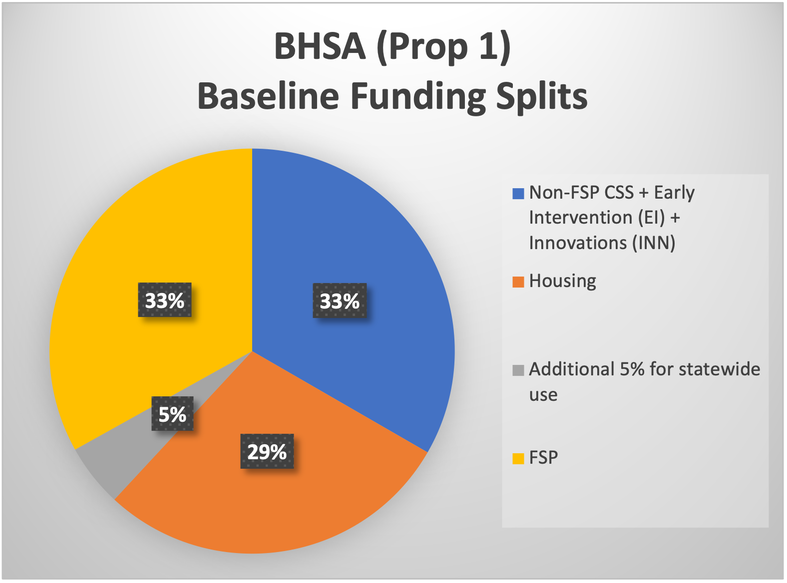

Slide 8
Prop 1: Services at Risk
Peer Support
Culturally specific services
Outpatient services
Consumer-run programs/Peer support/wellness centers
Augmented services in board and care facilities

Slide 9
Recovery-Oriented Services
Voluntary, community-based alternatives to traditional medical model treatment
Peers employed throughout the system
Services not normally covered by Medi-Cal
Principles:
  Recovery emerges from hope
  Recovery is person-driven
  Many pathways to recovery
  Encompasses an individual’s whole life
  Supported by peers and allies
  Culturally based and influenced

Slide 10
California is moving away from recovery-oriented care
CARE Court
Expansion of Involuntary Treatment criteria
Proposition 1
  Weakens the MHSA focus on recovery-oriented care
  Cuts funding for recovery-oriented services
  Puts increased pressure on counties to use MHSA funds for Medi-Cal match

Slide 11
5 Core Components for Equitable Care
Culturally responsive services and systems
Low-barrier access to services
Integrated peer support across the recovery continuum
Harm reduction approach
Address the needs of the whole person
Source: The Roadmap to Improve Access and Care for Diverse Communities in Mental Health and Substance Use Recovery

Slide 12
Prop 1: New BHSA Housing Component
Counties are required to spend 23-37% of their BHSA funds on “housing interventions”
  Rental subsidies
  Operating subsidies
  Shared housing
  Family housing
  Master leasing
This funding does not include services

Slide 13
Eligibility (Adults) for BHSA Housing Component
Chronically homeless (50% of funds), experiencing homelessness, or at risk of homelessness; and
Signficant impairment (distress, disability or dysfunction in social, occupational, or other activities
A diagnosed or suspected ”mental disorder”
Do not need to be on Medi-Cal
Do not need to be in an FSP

Slide 14
Service Access Concerns in BHSA housing:
People with a mental health challenge who are not on Medi-Cal and/or not in an FSP
BHSA Housing dollars do not fund services, housing offered is not supportive housing
Yet, people must have a mental health challenge to access housing
Where will this population receive behavioral health services?
Will the services be person-centered, culturally responsive, trauma-informed, voluntary, and community-based?

Slide 15
Demographics/Specialized Needs of the Unhoused
29% Black, 37% LatinX, 7% multi racial
LGBTQ+
High frequency of chronic health conditions and/or disability
48% of chronically unhoused have a DV history
72% report experiencing physical violence in their lifetime
Criminal justice history
Being unhoused is traumatic

Slide 16
And even if they do get linked into services:
Core Components of Equitable Care
Culturally responsive services and systems
Low-barrier access to services
Integrated peer support across the recovery continuum
Harm reduction approach
Address the needs of the whole person
BHSA Services at Risk
Culturally specific services
Outpatient services
Peer support and consumer-run programs
Community outreach services
Recovery-oriented services

Slide 17
Advocacy Opportunities
Participate in the local stakeholder planning process
Encourage the early development of regulations
Understand the BHSA. It still includes the same language around recovery as the MHSA and it includes language around underserved populations, CDEPS, and health disparities.
BHSA Section 5887 (Full Service Partnerships): DHCS and BHSOAC required to develop FSP standard of care and step-down criteria
BHSA Section 5840: Additional Early Intervention Components to be developed by DHCS and a biennial list of EBPs and CDEPs to be developed by DHCS and BHSOAC
Section 5840.7: DHCS and BHSOAC required to develop priorities for the use of Early Intervention funds

Slide 18
Equity Considerations in Access to Prop 1 Behavioral Health Services Act Housing
Mental Health America of California’s Perspective

Slide 19
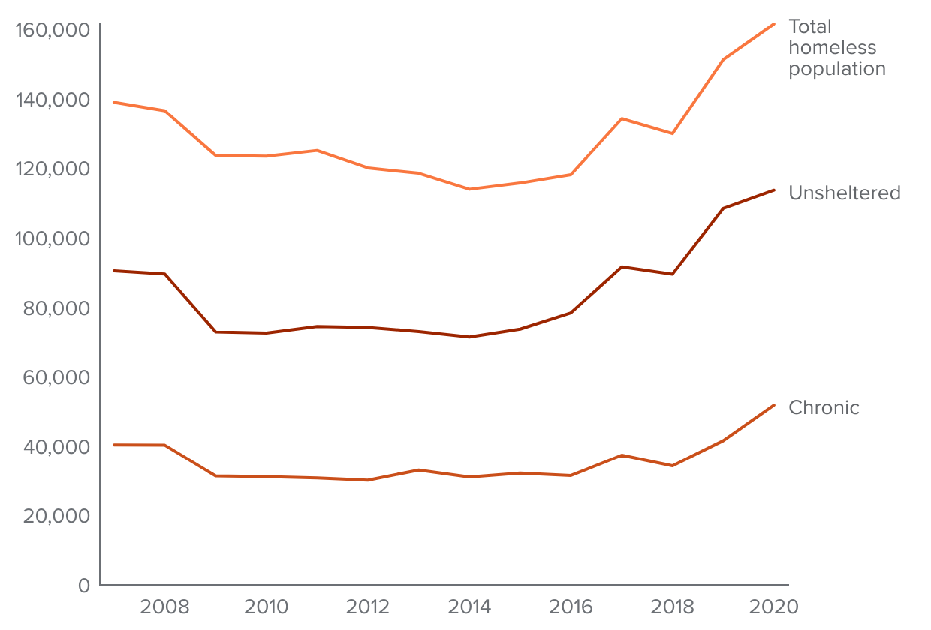
The Number of Unhoused in California 2008-2020

Slide 20
Why the Sudden Increase in 2018?
Housing costs began to increase more quickly
Point In Time Counts are conducted on a single night
  They can only count the people they can find
  It is believed that PIT counts underestimate the number of unhoused people
  People who are harder to find might not get counted
  More people were being counted

Slide 21
What Happened in 2018?
A District Court ruled, in Martin v. City of Boise, that encampments of unhoused people cannot be cleared if no shelter is available to them
The unhoused, who had previously been forced to hide, came out to public locations
  Closer to resources
  Safer
  Easier to count

Slide 22
The Number of Unhoused in California 2008-2020

Slide 23
2024 Encampment Sweeps
Recently, the Supreme Court effectively overruled the Boise Decision, allowing for anti-camping ordinances to be enforced
The unhoused, who had previously been allowed to sleep in public will likely go back into hiding
  Further from resources
  Less safe
  Harder to count
  PIT counts will likely be lower

Slide 24
Encampment Sweeps: Housing Access Equity Issues
In many towns and cities, the encampment clearings involve law enforcement/criminalization
Will those with a distrust of law enforcement become the hardest to find?
Will this result in decreased access to housing and services for POC and people with a criminal justice background?

Slide 25
Advocacy Opportunities
Stay educated and informed
Educate others
Work with your local Homeless Union and other groups on the ground
Advocate locally to end sweeps.
Advocate locally to eliminate law enforcement in sweeps, and to require housing, services and support before cleanups
Work to ensure that every single unhoused person is counted
If the number of unhoused people suddenly decreases, understand why this number may not be accurate

Slide 26
Thank you!
Karen Vicari, JD
Interim Director of Public Policy
kvicari@mhaofca.org

